Slide 1

Blockchain-Based DNS
by Omar Khalifa (247923)
Notes:
1. Table of contents
2. Introduction
3. Our company
4. Our team
5. Problem
6. Them vs. us
7. Solution
8. SWOT analysis
9. Product overview
10. Our plans
11. Product demo
12. Traction
13. Case study
14. Reviews
15. Awards
16. Market size
17. Target
18. Competitors
19. Business model
20. Timing
21. Predicted growth
22. Investment

Slide 2
Table of Contents
01
02
03
04
Introduction
Background
A brief introduction about the project and its objectives.
Review on necessary topics and definitions.
Problem
Solutions
Discuss problems of centralized DNS.
Discuss related work and existing solutions and provide implemented solution.

Slide 3
01
Introduction
What is this project all about?

Slide 4

Introduction
A decentralized Domain Name System (DNS) built on Ethereum smart contracts, combining the security of blockchain with recursive DNS resolution capabilities. This project demonstrates how blockchain can eliminate centralized DNS vulnerabilities while maintaining interoperability with the existing DNS ecosystem.

Slide 5
02
Background
Important topics & definitions

Slide 6
DNS
BC
ENS
NC
DNS
Blockchain
ENS
Namecoin
Domain Name System
Blockchain Technology
Ethereum Naming System
Namecoin

Slide 7
DNS
The Domain Name System (DNS) is a hierarchical and decentralized naming system used on the Internet that translates human-readable domain names, such as example.com, into Internet Protocol (IP) addresses, such as 192.0.2.1.
DNS
visit domain.net
domain.net?
Root Server
Domain Name System
.NET
DNS query
How it works
A user enters a domain name in a web browser.
The resolver queries the DNS hierarchy starting from the root name server, then the Top-Level Domain (TLD) name server, and finally the authoritative name server.
The IP address corresponding to the domain is returned and cached.
The browser connects to the web server using the resolved IP address.
domain.net?
IP 1.2.3.4
DOMAIN.NET
Current Architecture
Hierarchical structure consisting of root servers, TLD servers, and authoritative servers.
Centralized control, where a small number of organizations manage the root zone.
Local DNS Server
TLD Server
domain.net?
IP 1.2.3.4
Authoritative DNS Server
BC
ENS
NC
Blockchain
ENS
Namecoin
Blockchain Technology
Ethereum Naming System
Namecoin

Slide 8
DNS
BC
ENS
NC
DNS
Blockchain
ENS
Namecoin
Domain Name System
Blockchain Technology
Ethereum Naming System
Namecoin

Slide 9
BC
Blockchain is a distributed ledger technology that maintains a continuously growing list of records, called blocks, which are linked using cryptography.
+ hash
Blockchain
Blockchain Technology
+ hash
Data
Key Properties
Immutability: Once data is recorded, it cannot be altered.
Decentralization: No single point of control.
Transparency: All transactions are visible to network participants.
+ hash
+ hash
DNS
ENS
NC
DNS
ENS
Namecoin
Domain Name System
Ethereum Naming System
Namecoin

Slide 10
DNS
BC
ENS
NC
DNS
Blockchain
ENS
Namecoin
Domain Name System
Blockchain Technology
Ethereum Naming System
Namecoin

Slide 11
ENS
ENS
The Ethereum Naming System (ENS) is a decentralized naming protocol built on Ethereum that allows the registration and management of human-readable domain names mapped to Ethereum addresses.
Ethereum Naming System
DNS
BC
NC
DNS
Blockchain
Namecoin
Domain Name System
Blockchain Technology
Namecoin

Slide 12
DNS
BC
ENS
NC
DNS
Blockchain
ENS
Namecoin
Domain Name System
Blockchain Technology
Ethereum Naming System
Namecoin

Slide 13
NC
Namecoin
Namecoin
Namecoin is a peer-to-peer naming system based on Bitcoin’s blockchain that introduces an alternative root zone using the .bit top-level domain.
DNS
BC
ENS
DNS
Blockchain
ENS
Domain Name System
Blockchain Technology
Ethereum Naming System

Slide 14
DNS
BC
ENS
NC
DNS
Blockchain
ENS
Namecoin
Domain Name System
Blockchain Technology
Ethereum Naming System
Namecoin

Slide 15
03
Problem
Discuss problem statement

Slide 16
Problem
Single Point of Failure
Cache Poisoning
Censorship
The reliance on a small number of centralized root and TLD servers where a single technical failure or targeted attack can disconnect vast portions of the global internet.
An attack that injects fraudulent IP data into a resolver's memory, causing it to direct users to malicious websites even when they type the correct domain name.
The practice where central authorities or service providers intentionally manipulate DNS records to block access to specific websites or redirect users away from restricted content.

Slide 17
04
Solutions
Existing solutions and project implementation

Slide 18
Existing Solutions
Technology | Solution | Limitation
DNSSEC | Introduces cryptographic signatures to authenticate DNS records and mitigate cache-poisoning attacks. | DNSSec adoption remains limited, and it doesn't address the fundamental issue of centralized authority at the root level.
DecDNS | Construct multiple parallel nodes that store root file information on a blockchain. The system uses hash-based storage mechanism. | Doesn't implement a full resolver pipeline or address real-time resolution resolver. Only focuses on Zone file storage and synchronization
B-DNS | Leverages hierarchical multi-chain structure to decentralize TLD management and domain record updates. Incorporates Smart Contracts to enforce ownership and update rules and uses Blockchain consensus to secure changes to DNS data. | remains conceptual. No operational resolver implementation. No resolver performance evaluation, latency, or deployability. Interoperability with legacy DNS is not addressed.

Slide 19
Blockchain-Native Naming System
Technology | Solution | Limitation
Namecoin | Stores .bit domain registrations directly on its blockchain. | Restricted adoption due to the absence of compatibility with the DNS Hierarchy and reliance on specialized TLD.
ENS | Provides human-readable names mapped to Ethereum addresses and resources via smart contracts. | Requires external bridges for DNS compatibility.
Handshake | Decentralized alternative root zone where ownership of TLDs is secured through blockchain. | Doesn't integrate with existing recursive resolvers. Deployment complexity and lack of widespread recursive support.

Slide 20
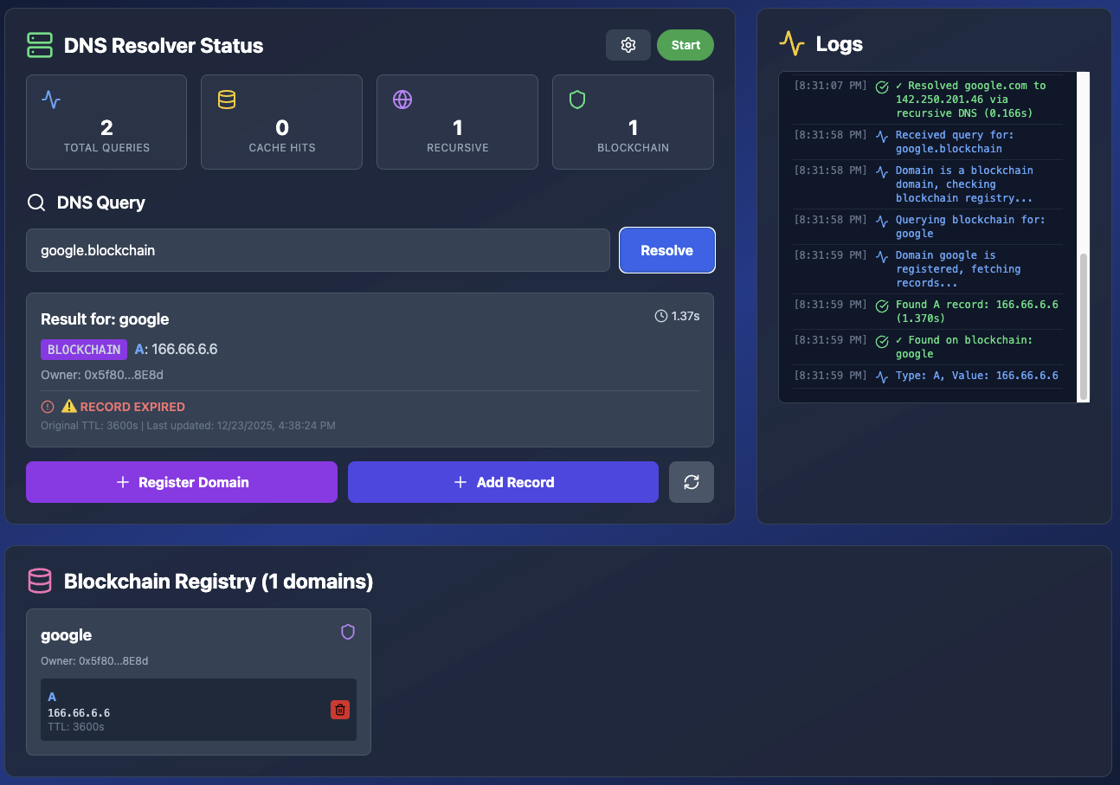
Project Demo
Provide blockchain-based DNS that integrates smart-contract-controlled domain records with recursive resolver functionality while maintaining the interoperability with existing DNS ecosystem.

Slide 21
Project Demo
Features
Resolve domain (Traditional DNS & Blockchain Smart Contract)
Register Domain Name on Blockchain Smart Contract
Add Records to Blockchain Registered Domains
Provide blockchain-based DNS that integrates smart-contract-controlled domain records with recursive resolver functionality while maintaining the interoperability with existing DNS ecosystem.

Slide 22
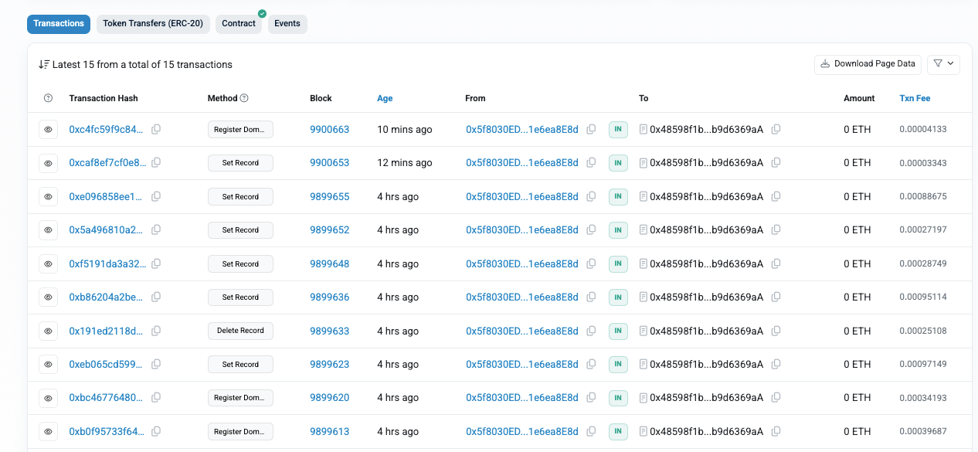
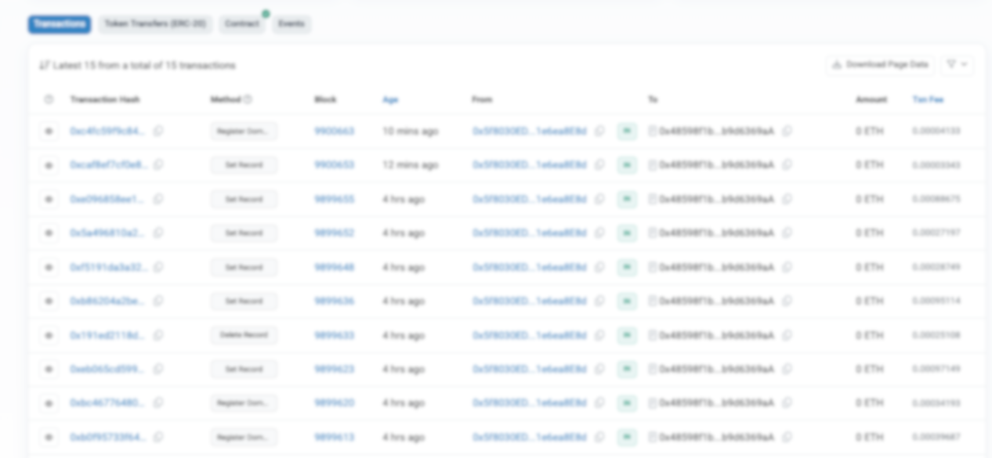
ALL TRANSACTIONS ARE SIGNED ON BLOCKCHAIN

Slide 23
Conclusion
This project demonstrates that a decentralized DNS system built on blockchain smart contracts is both technically feasible and operationally viable. By combining blockchain immutability with recursive DNS resolution, this work addresses key vulnerabilities in traditional infrastructure.

Slide 24
References
Blockchain based DNS and PKI solutions.
B-DNS: A secure and efficient DNS based on the blockchain technology.
A data storage method based on blockchain for decentralization DNS.
—Karaarslan, E., and Adiguzel, E. (2018).
—Li, Z., et al. (2021).
—Liu, J., et al. (2018).

Slide 25
Thank you!

